Slide 1
Batbot Control Parameters Optimization
Through Evolutionary Algorithm
MASTER THESIS ORAL DEFENSE
Anuar Santoyo alum 安武 2022280136
Supervisor: Prof. ZHANG YUN张云
2024/05/28

Slide 2
TABLE OF CONTENT
Batbot
Evolutionary Algorithm
Experiments and Design Optimization
Bio-mimick Optimization

Slide 3
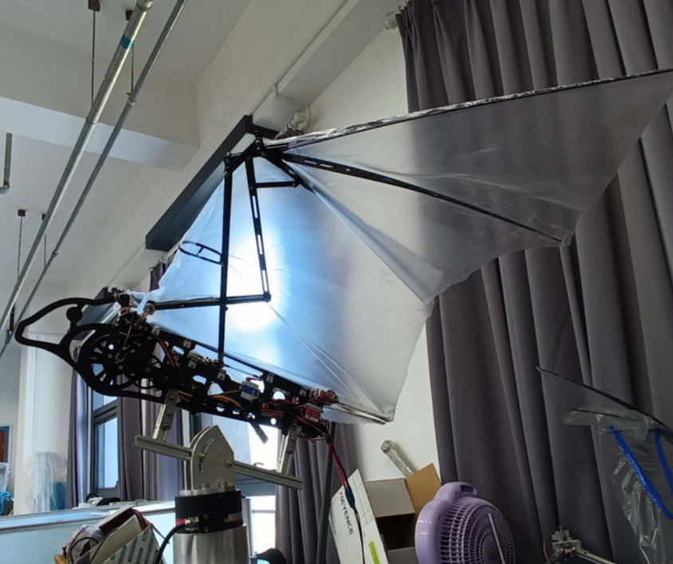
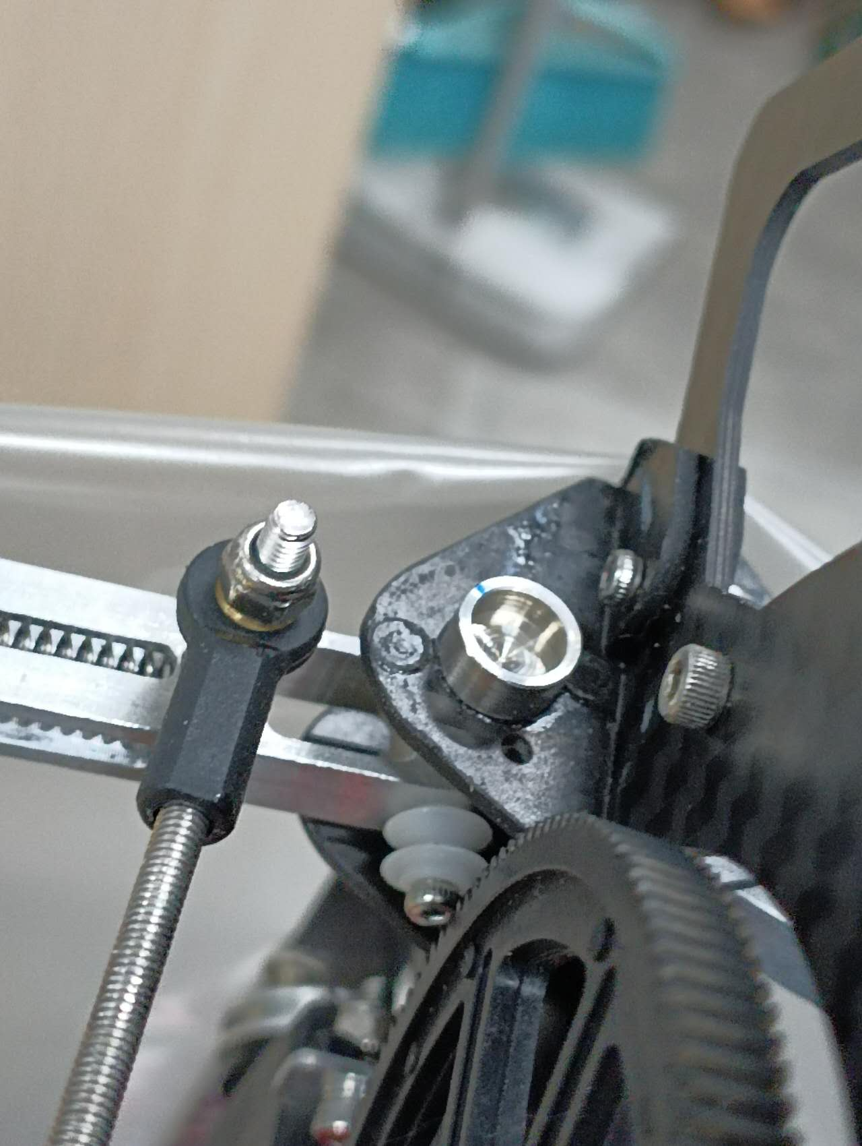
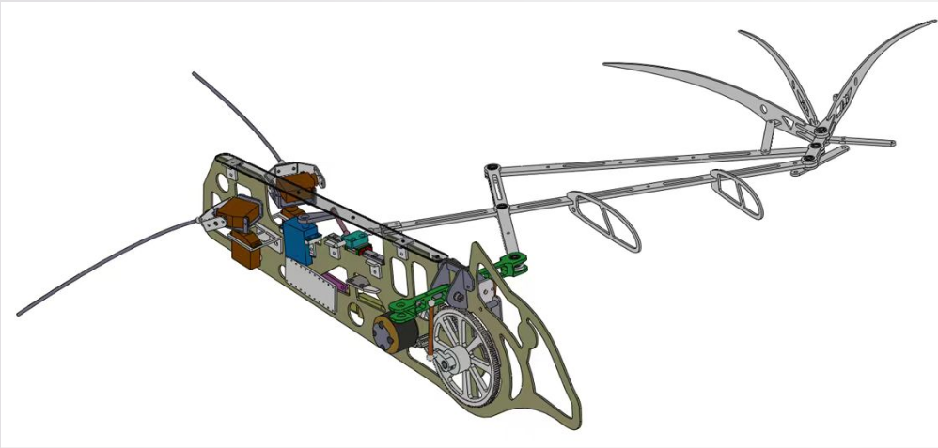
BATbot - Design
Inspired in the fruit bat
6 DOF:
Flapping
2 DOF per hind leg (4 DOF)
Extension of wing
Carbon fiber body
Silicone elastic membrane
Magnetic Encoder for wing angle
Page 1

Slide 4
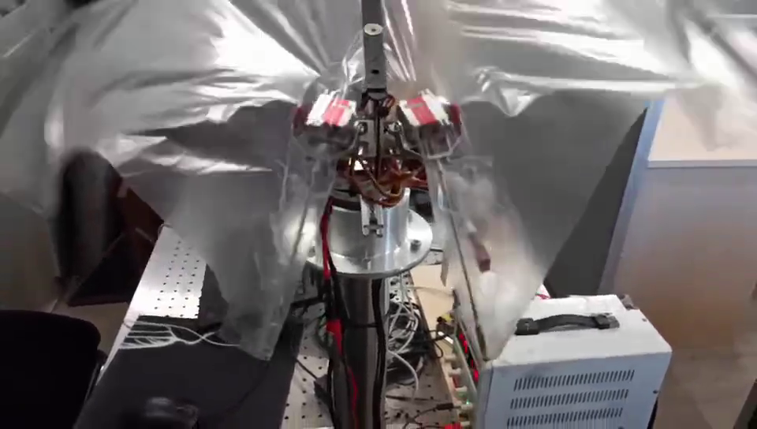
Batbot - controlling
How to find the best strategy of hind-leg movement for highest force?
Page 2

Slide 5
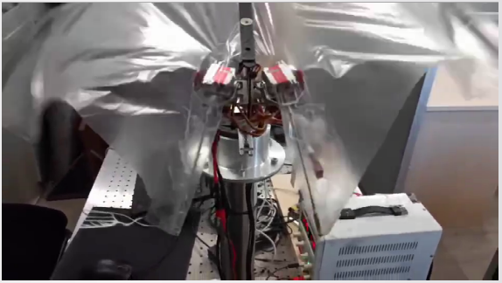


Batbot - controlling
Try all possible combinations:
1 dim: 10 * 6s = 1min
5 dim: 10^5*6s = 167 hours = 1 week
Simulation
Elastic Membrane and Fluid Dynamic
Solution: EA Strategy
How to find the best strategy of hind-leg movement for highest force?
(X, Y) mid. point
Page 2

Slide 6


Evolutionary algorithm - General
Computer running CMA
1st Step: Evolutionary algorithm Covariance Matrix Adaptation (CMA) proposes 10 solutions (Ex. Angle and amplitude)
2nd Step: 10 Tests are carried out in the test bench and using the sensors a score is calculated for each test
10 Scores
10 Solutions
3rd Step: Scores of the tests are given back to the computer so that the CMA can use information to propose other 10 solutions
Page 3
10 Tests in Testbench

Slide 7
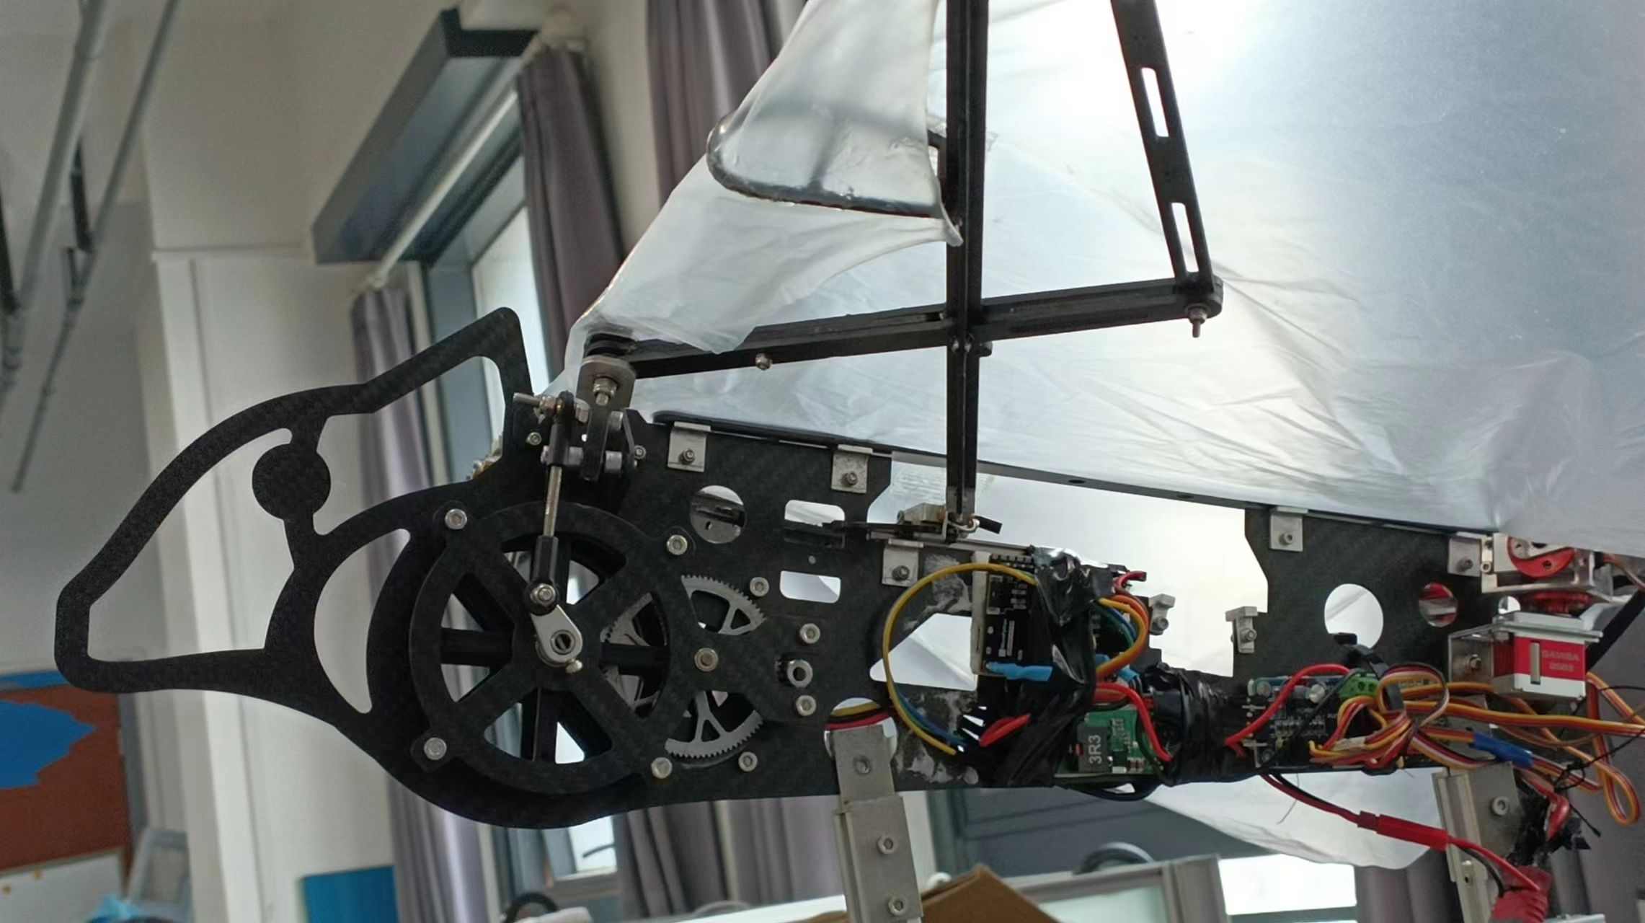

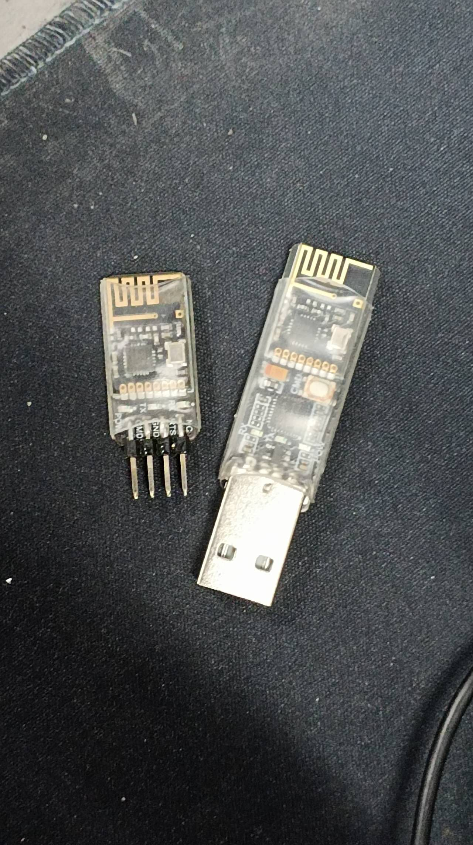
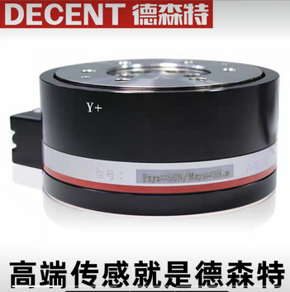
Evolutionary algorithm - workflow
Batbot with PyBoard (MicroPython)
Wireless UART
6 Axis Measurements
Computer - Python
Measurements
Page 4

Slide 8
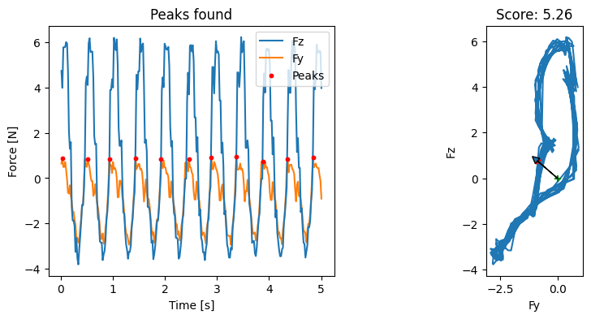
Evolutionary algorithm - testbench
Testbench and Measurements
Fz
Fy
Page 5

Slide 9
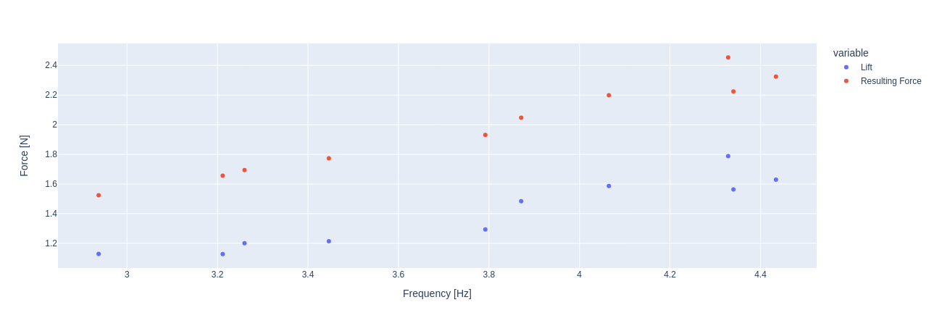
Experiments and design optimization – Frequency vs force
Experiment with increasing power to analyze average lift and resulting average force for a 7N heavy Batbot
Page 6

Slide 10
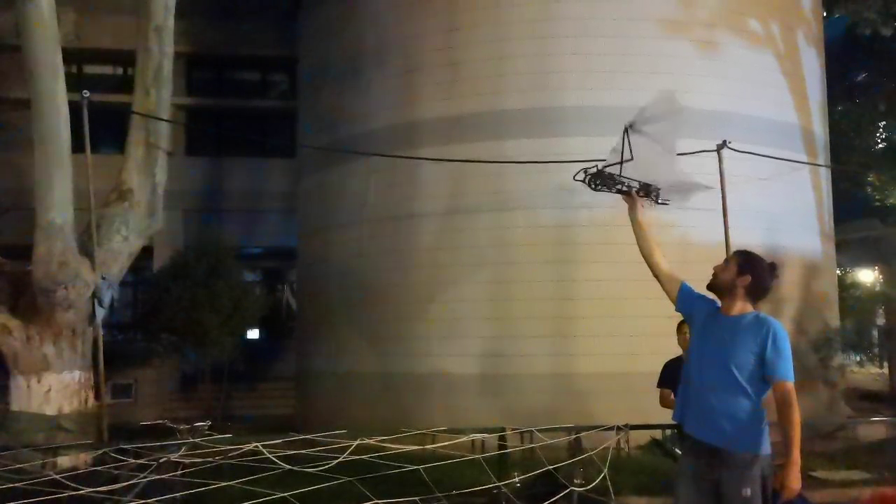
Experiments and design optimization – Frequency vs force
Initial experiment WITHOUT controlling
Why are 3N enough to make Batbot fly?
→ wing foil does not generate lift in hovering.
Need to upgrade Batbot to achieve higher forces for hovering.
Page 7

Slide 11
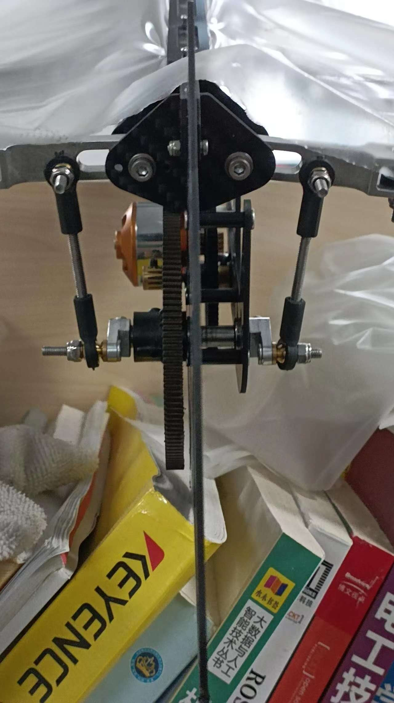
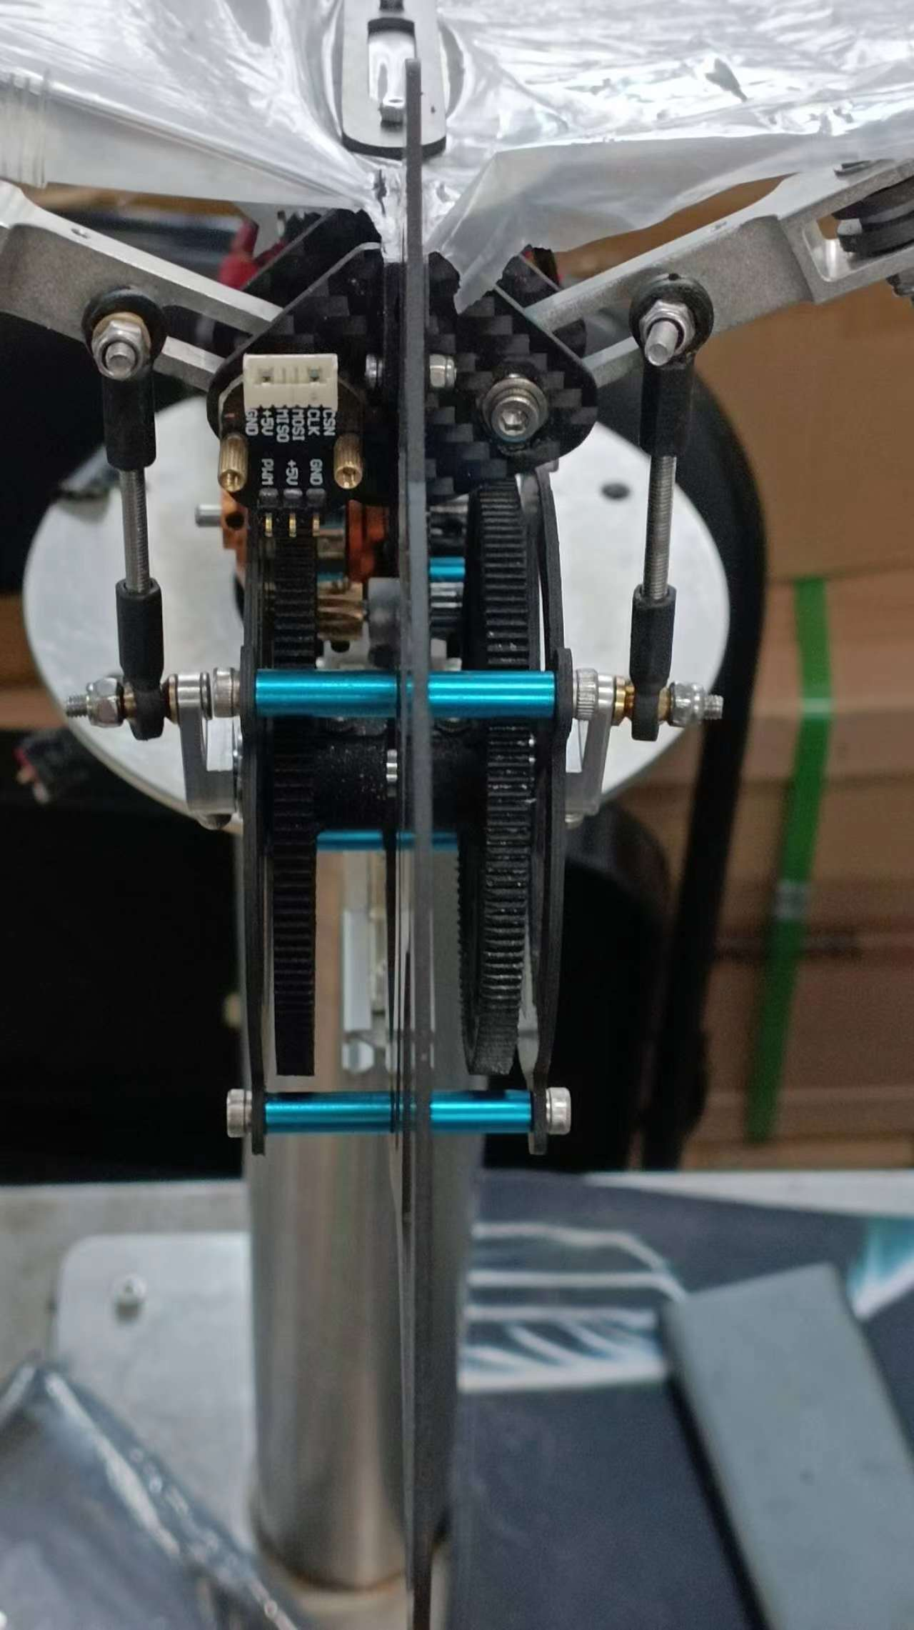
Experiments and design optimization - Batbot upgrade
UPGRADE
2 main gears
50 Amp Electronic Speed Controller
100 W DC Motor
Higher Flapping Amplitude
Page 8

Slide 12
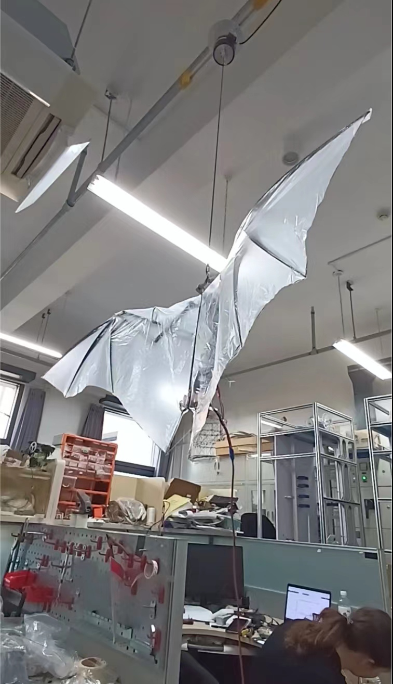
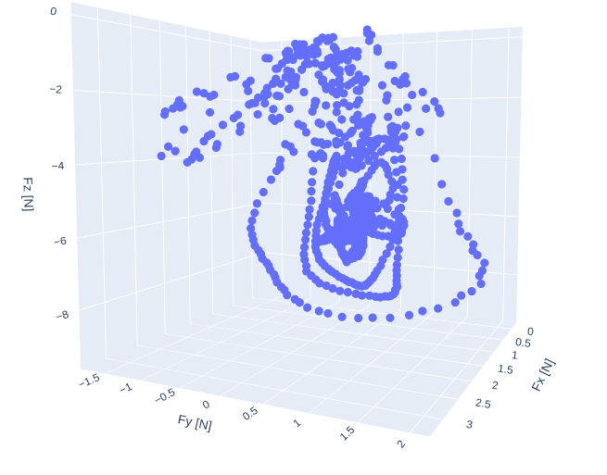
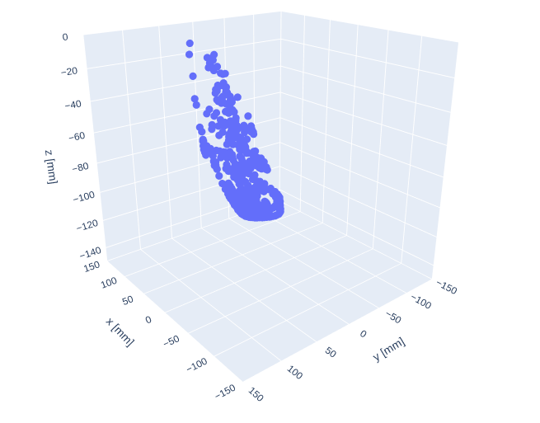
Experiments and design optimization -
Dynamic Test-bench test
Safe multiple hovering tests
Realistic circumstances
If hovering, Batbot drawn to center, otherwise a force is measured.
With Hookes Law position known from force
F = k*x
Force
Page 9
Position

Slide 13
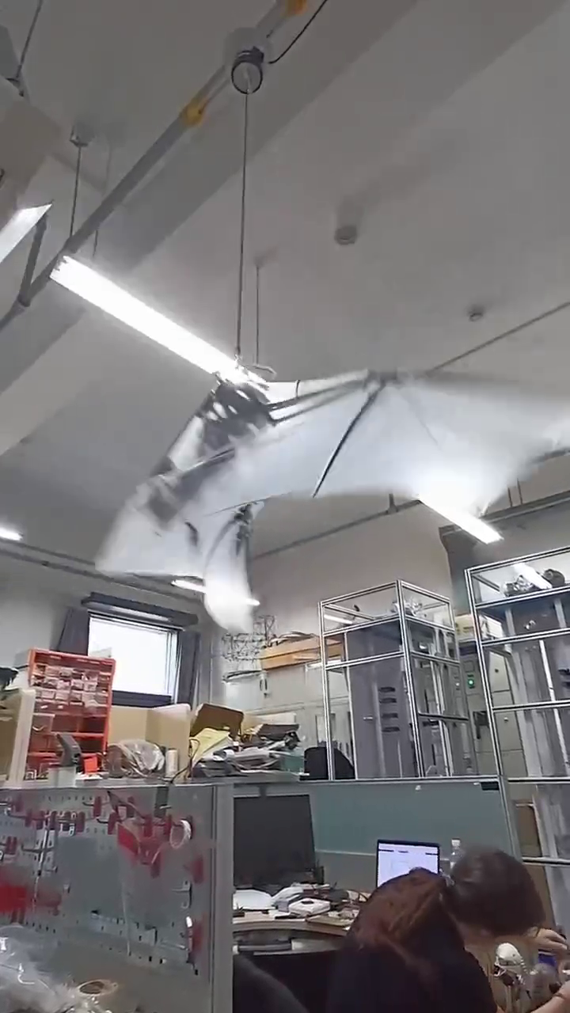
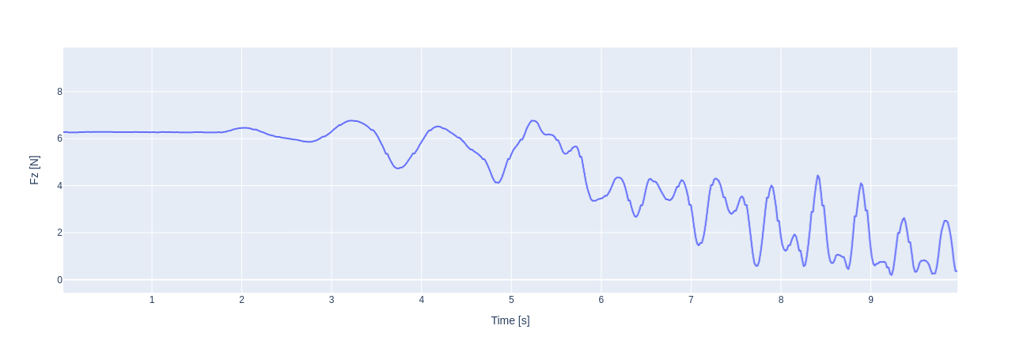
Experiments and design optimization Dynamic test-bench results
Experiments Result: Upgraded version of Batbot is capable of generating enough lift to hover.
Page 10

Slide 14
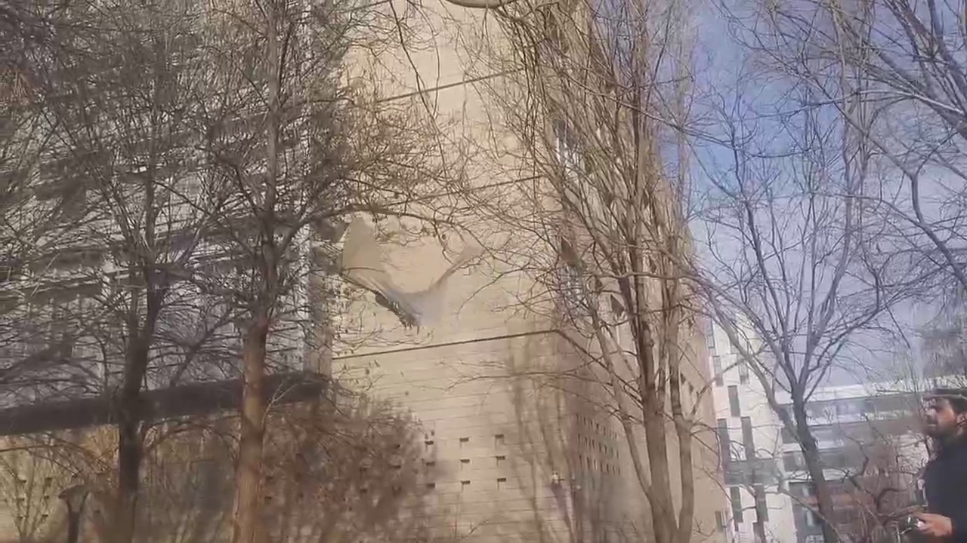
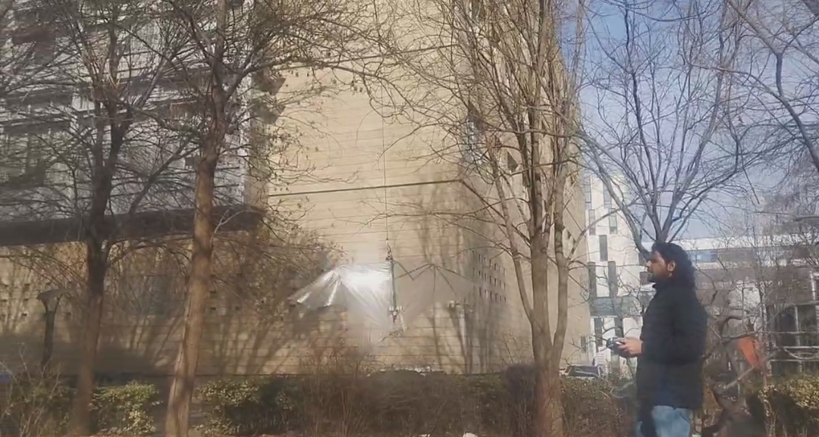
Experiments and design optimization - Outdoors experiments Tied
Experiment Result: Batbot lifts and is relatively stable..
Page 11

Slide 15
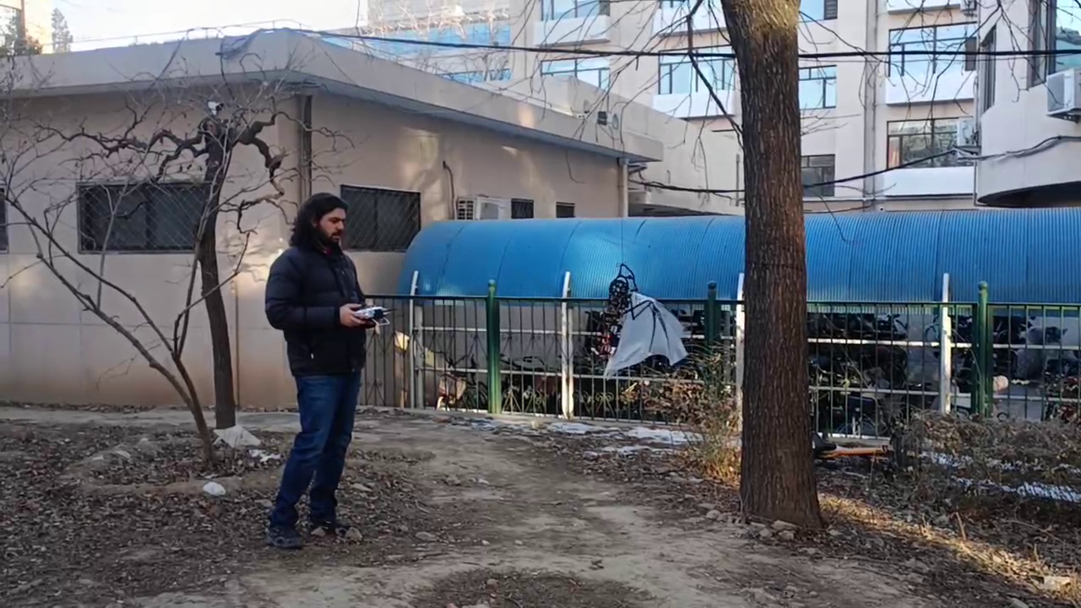
Experiments and design optimization - Outdoors experiments Rotation
Experiment Result: It is possible to control to a certain degree the rotation of the Batbot mid-flight
Page 12

Slide 16
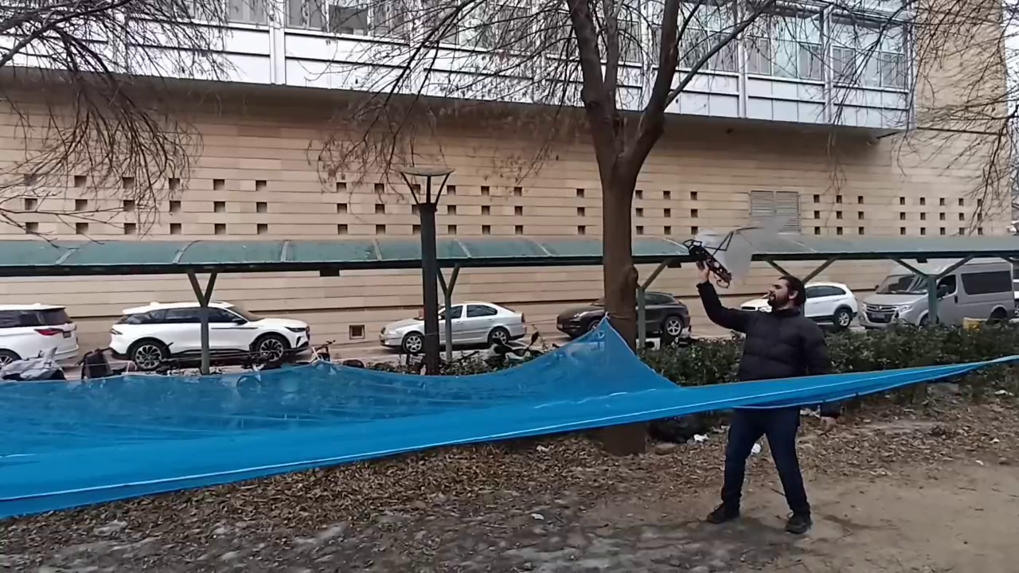
Experiments and design optimization
Outdoors experiments free flight
Experiment Result: Initial free hand controlled hovering experiments as a starting point to be refined using the optimization algorithm.
Page 13

Slide 17
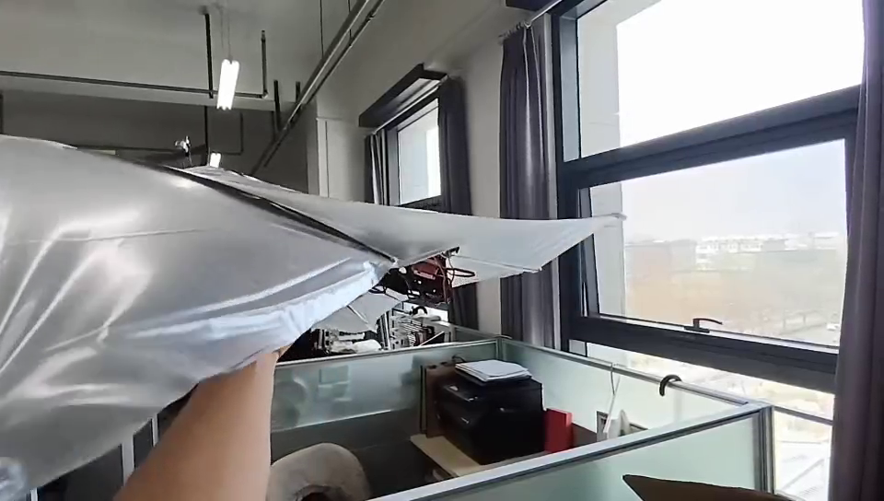
Experiments and design optimization - PID
Developed working feedback control using PID and MPU Sensor
Page 14

Slide 18
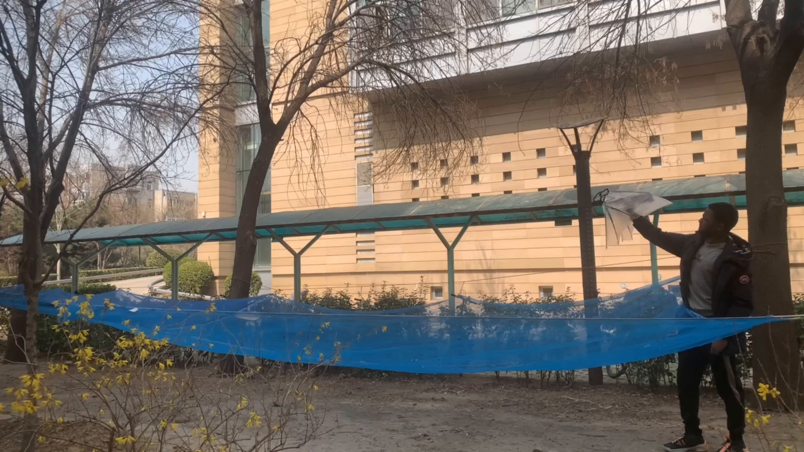
Experiments and design optimization - pid
Flight Test Using PID was successful
Batbot mechanical and electronical design phase concluded
Next step:
Use of EA to obtain controlling strategy
Page 15

Slide 19
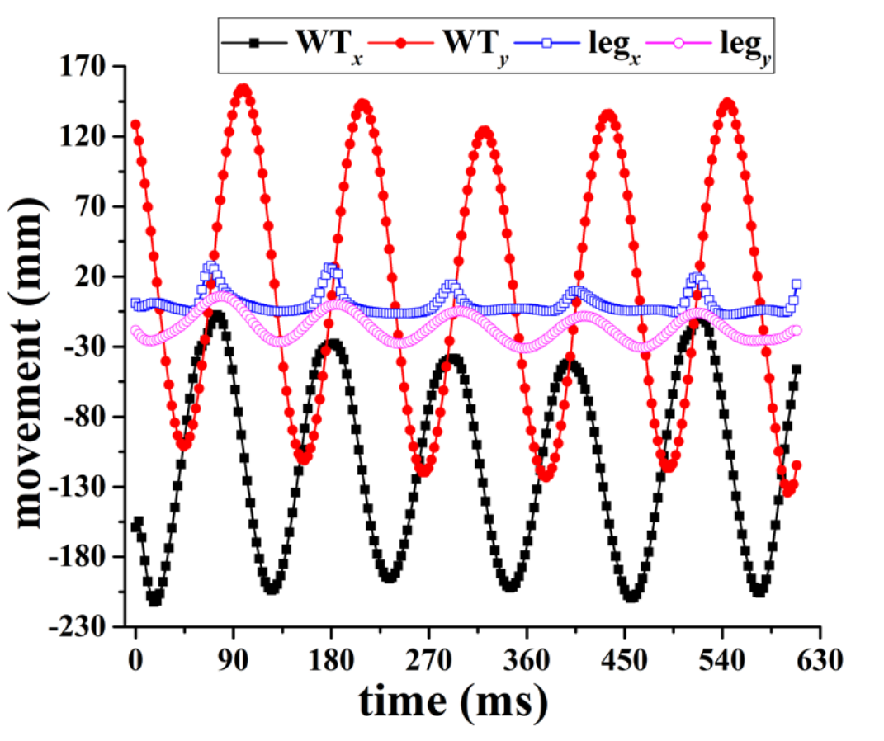
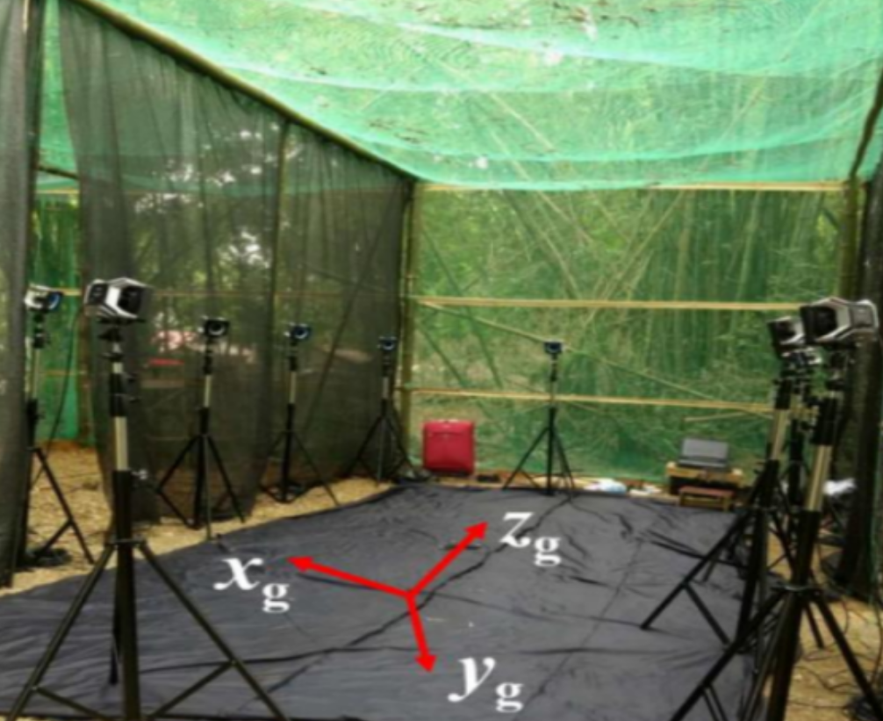
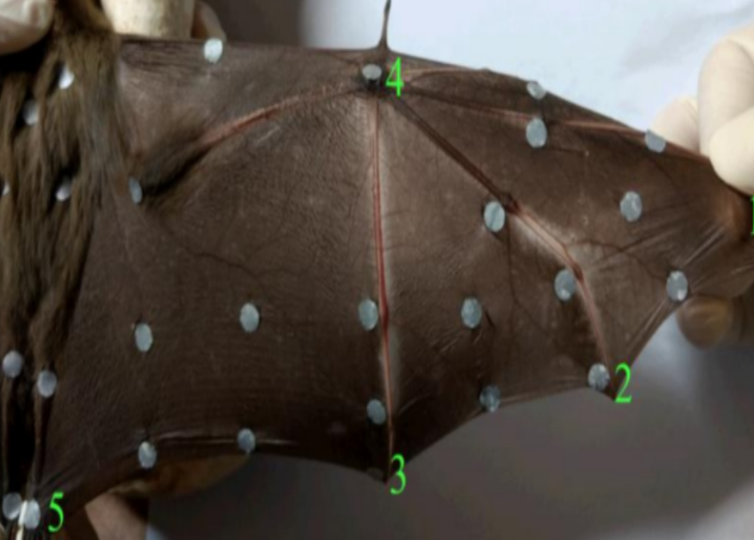
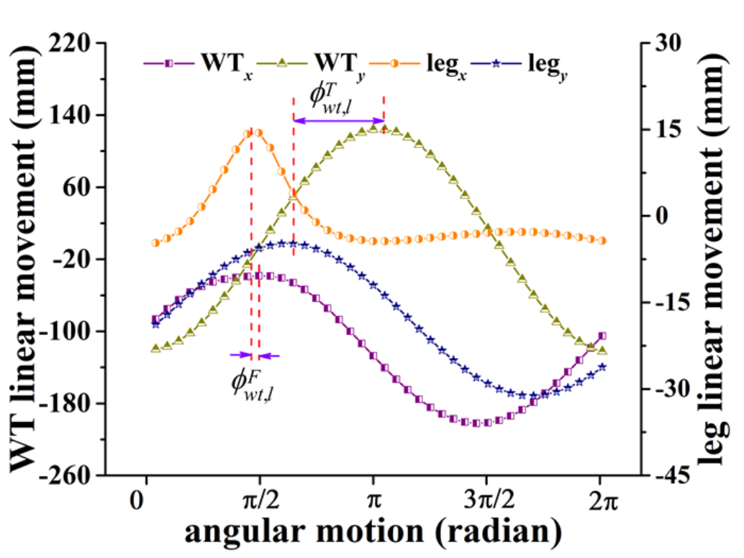
Biomimicking – real bat data
Thanks to Dr. Singh’s dissertation “Kinematic Analysis of a Bat Flight Based on Membrane Wing Motion Reconstruction” we obtained valuable data on the real bat flight data.
Page 16

Slide 20
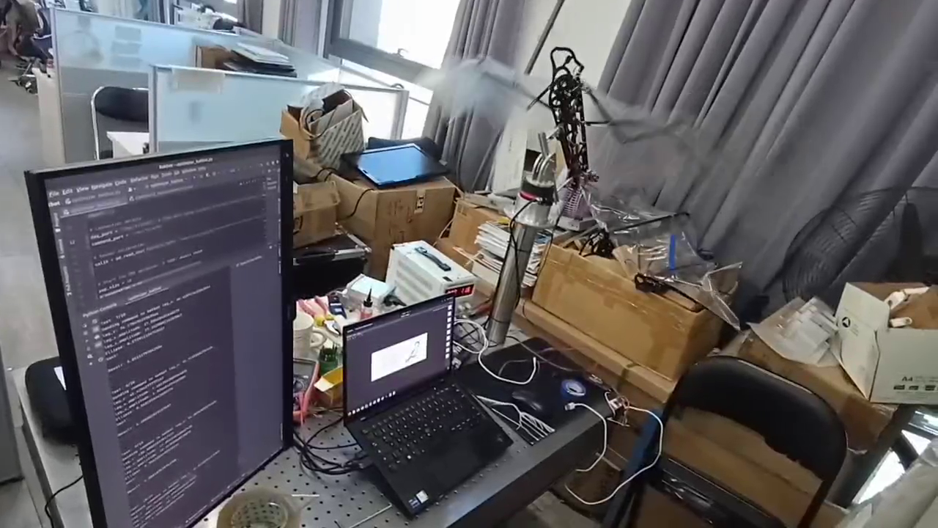
Biomimicking - optimization
Find optimal:
X amplitude (horizontal)
Y amplitude (vertical)
Y neutral angle
Phase shift between wing and tail flapping
Page 17

Slide 21
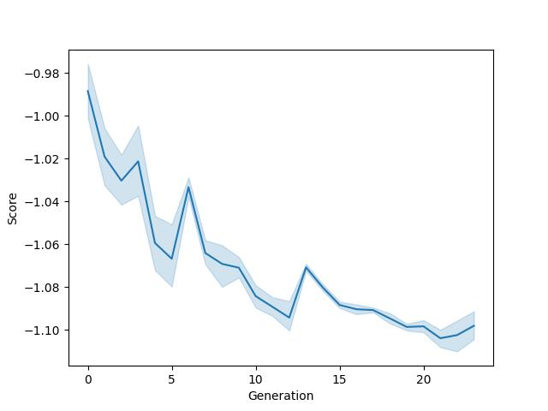
Biomimicking - result
Results:
Constant improvement
Within 25 generations convergence is achieved
25 Generations
* 10 Test = 250 Tests
250 Tests * 6s = 25 min
in only 25 min!
Instead of 1 week
Page 18

Slide 22
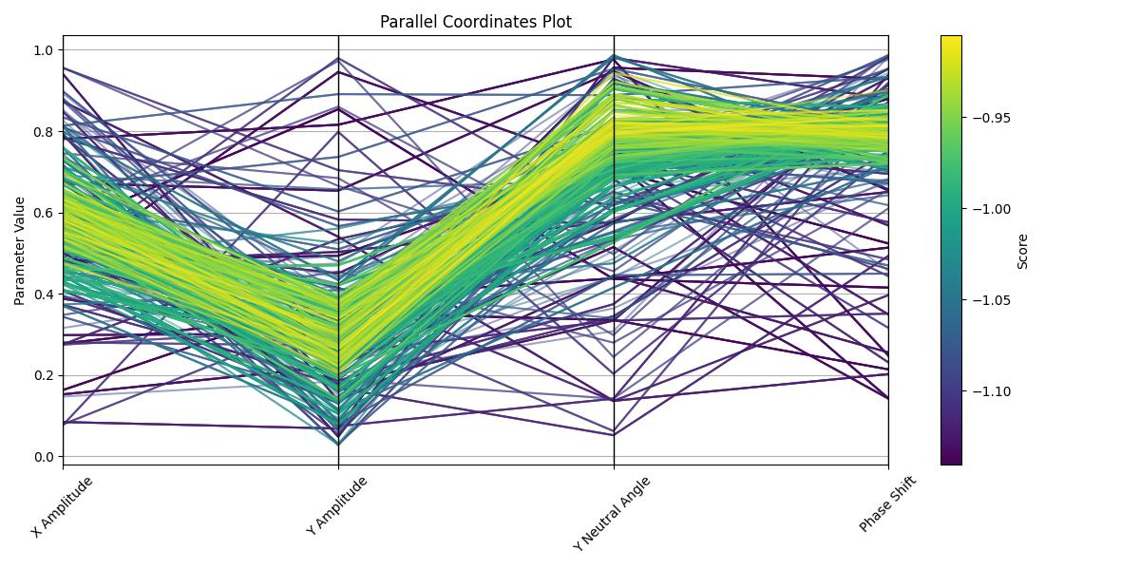
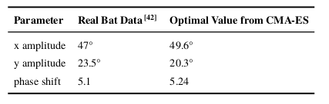
Biomimicking - result
Results:
Clear convergence to an optimal solution
Solution identical to real bat data
EA and the Batbots design are functional and accurate.
REAL BAT DATA
Page 19

Slide 23
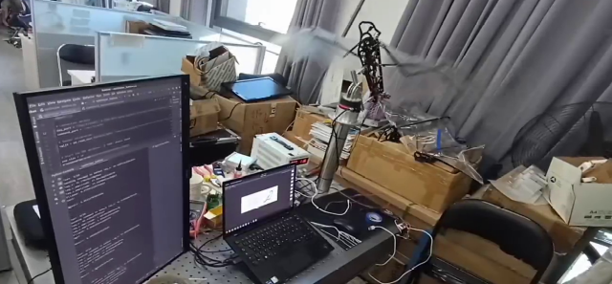
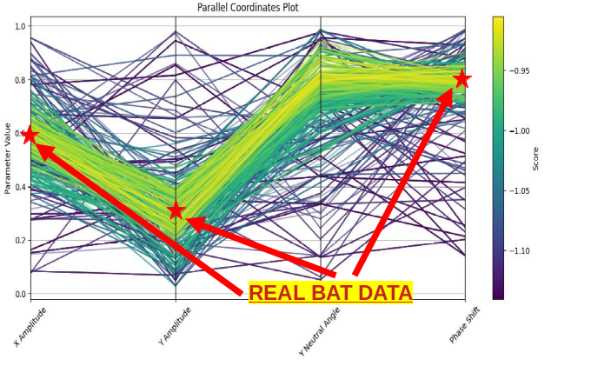
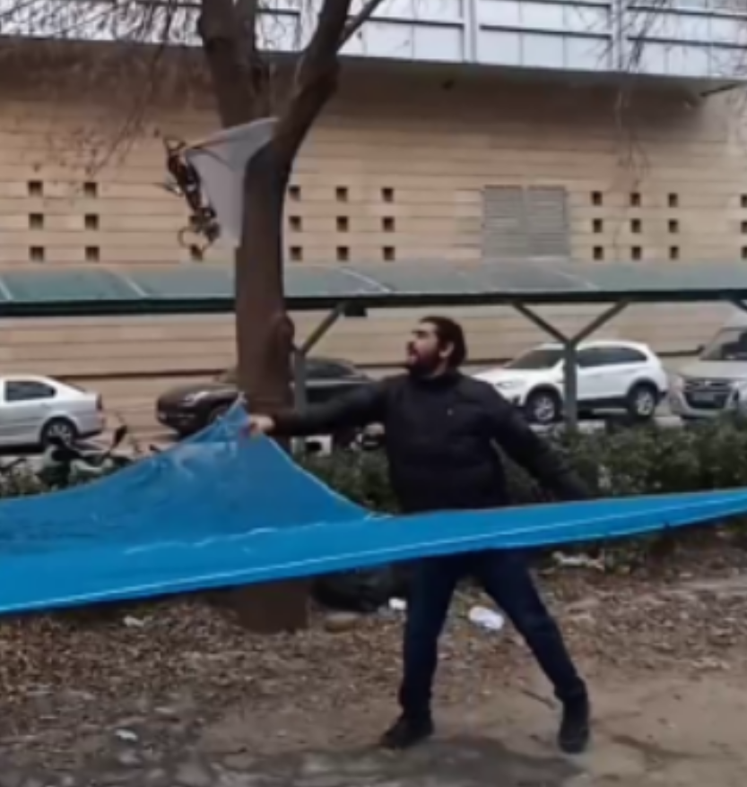
conclusion
Developed EA for complex robot controlling
Used EA to optimize Batbot and its design to achieve controlled flight
Validated design and system with real bat data (future step, publish results)
Page 20

Slide 24
Academic achievements
As part of the double degree program between the Technical University of Berlin and Tsinghua University I:
Published:
Santoyo Alum, A.; Fay, T.-A.; Cigarini, F.; Göhlich, D. Assessment of Thermal Comfort in an Electric Bus Based on Machine Learning Classification. Appl. Sci. 2023, 13, 11190.
Parameter Optimization of Additive Manufacturing Process LPBF Using an Evolution Strategy Algorithm Applied on the Material Tungsten Carbide Cobalt WC – Co 83/17 Eckart Uhlmann, Julian Polte, Josué Dávila Cherres, Jaroslaw Kochan and Anuar Santoyo Alum. Advance in material Science, vol 64. chapter 8
Jing-Shan Zhao, Han-Lin Sun, Xiao-Cheng Sun, Anuar Santoyo Alum. Tension Optimization of Cable-driven Robot by Screw Statics, 6th IEEE/IFToMM International conference on Reconfigurable Mechanism Robots
Conference
“Assessment of Thermal Comfort in an Electric Bus Based on Machine Learning” Anuar Santoyo Alum, Classification 2nd International Virtual Conference on Materials Science and Engineering held during November 11-12, 2023
Page 21

Slide 25
Academic achievements
As part of the double degree program between the Technical University of Berlin and Tsinghua University I:
Submitted:
Hybrid design and biomechanics tests of a robotic bat with morphing membrane wings. Jinghu Li, Anuar Santoyo Alum, Jing-Shan Zhao, 24th IFToMM China International Conference on Mechanism and Machine Science & Engineering
Working on:
EA to validate Batbot controlling strategy with real bat data., Kunar Singh Sudeep, Anuar Santoyo Alum
Awards
International Student Scholarship Tsinghua University, Department of Mechanical Engineering 2023
Page 22

Slide 26
Thank you for your attention!
More than happy to answer any question

Slide 27
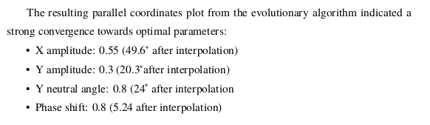
appendix

Slide 28
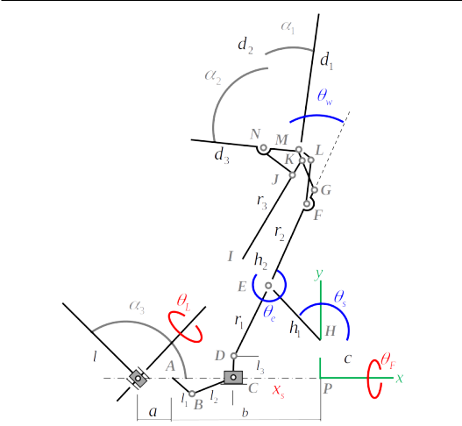
appendix

Slide 29
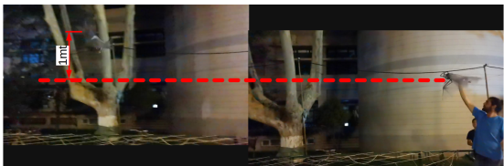
appendix

Slide 30
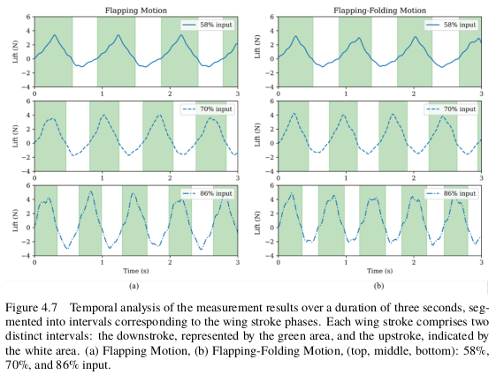
appendix

Slide 31
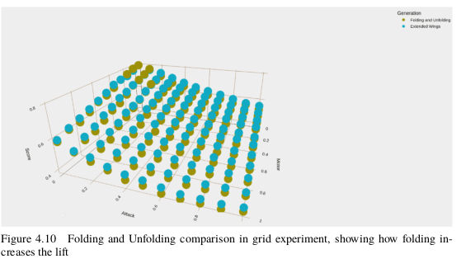
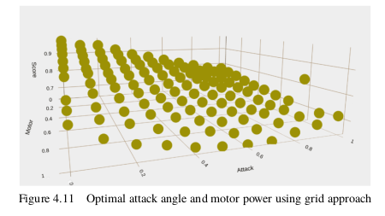
appendix

Slide 32
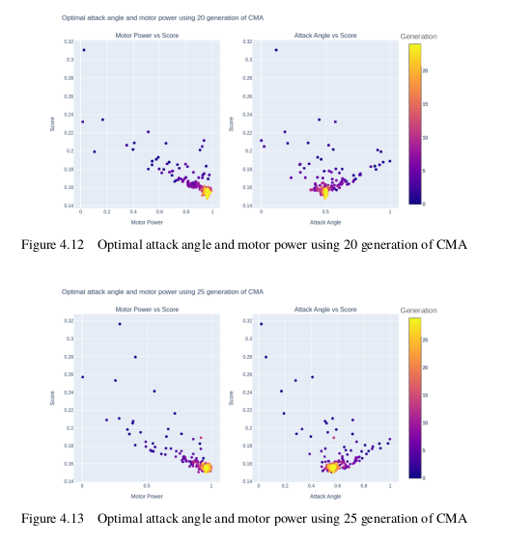
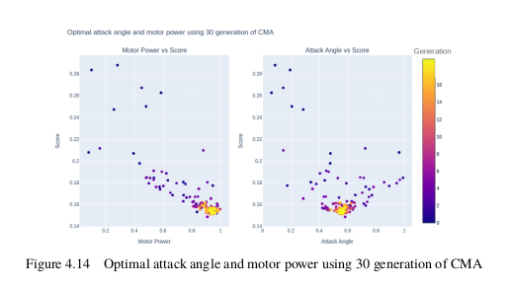
appendix

Slide 33
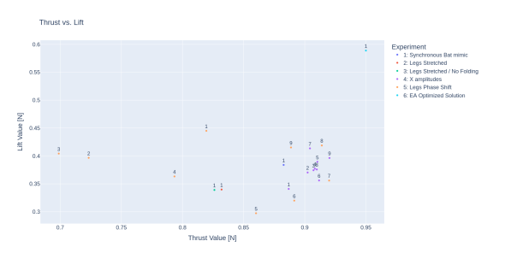
appendix

